Slide 1


GIT -Tips & Tricks
https://www.flickr.com/photos/44458147@N00/
Chris Ballance
@ballance
Diligent Board Member Services

Slide 2
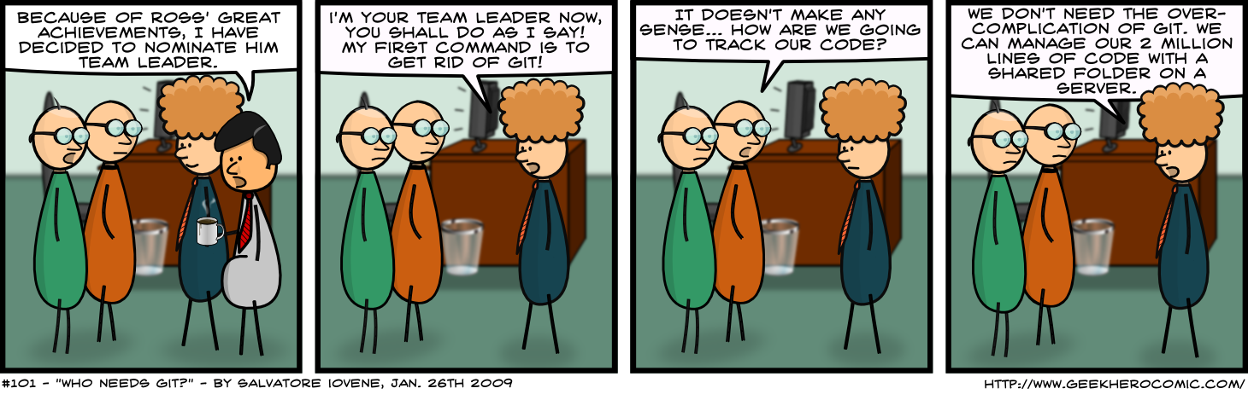
http://www.geekherocomic.com/2009/01/26/who-needs-git/index.html

Slide 3
My experience with SC
Nothing, why would I need Source Control?
I should probably back up my work. Zip file?
We use Visual Source Safe at work, I’ll learn that. VSS is awful, especially remotely, but it’s something.
TFS. Many years of TFS. Centralized repo, integrated well with Visual Studio.
GIT. Used for OSS contribution, personal projects, and finally I get to use it on a daily basis for “real” work.

Slide 4
A brief history of
Source Control In three phases

Slide 5
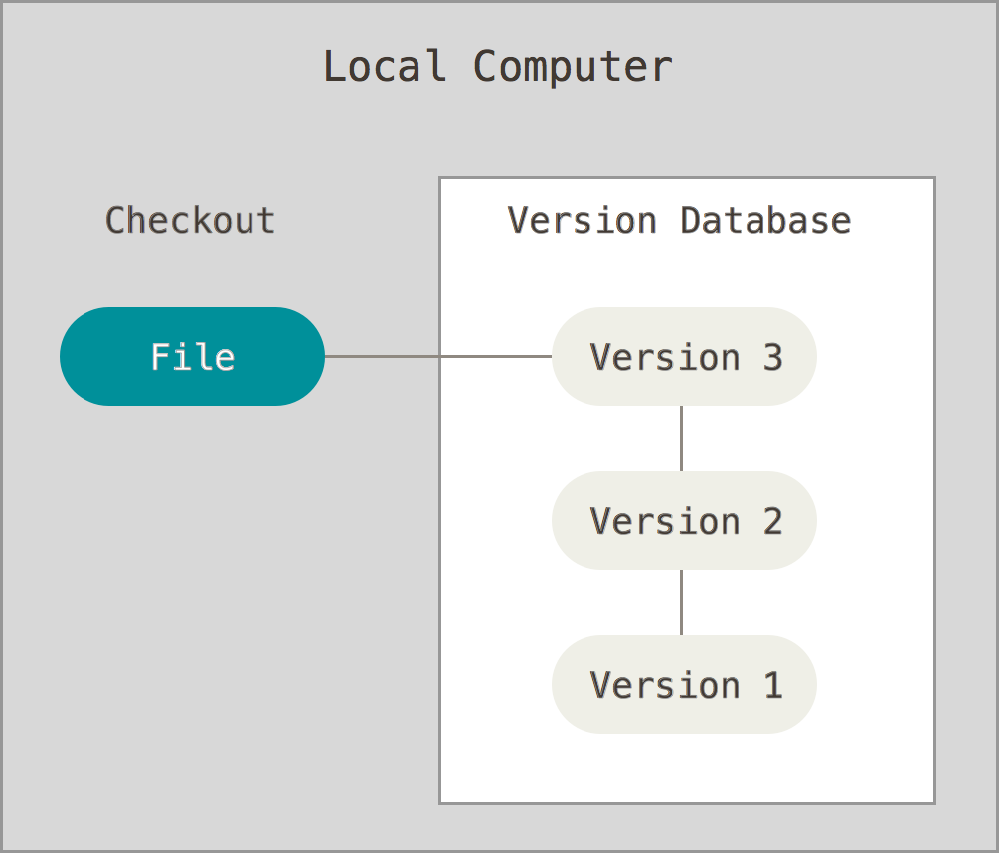
1. Local Source Control
Slightly better than dropping files in a folder and time-stamping them
RCS, VSS
http://git-scm.com/book/en/v2

Slide 6
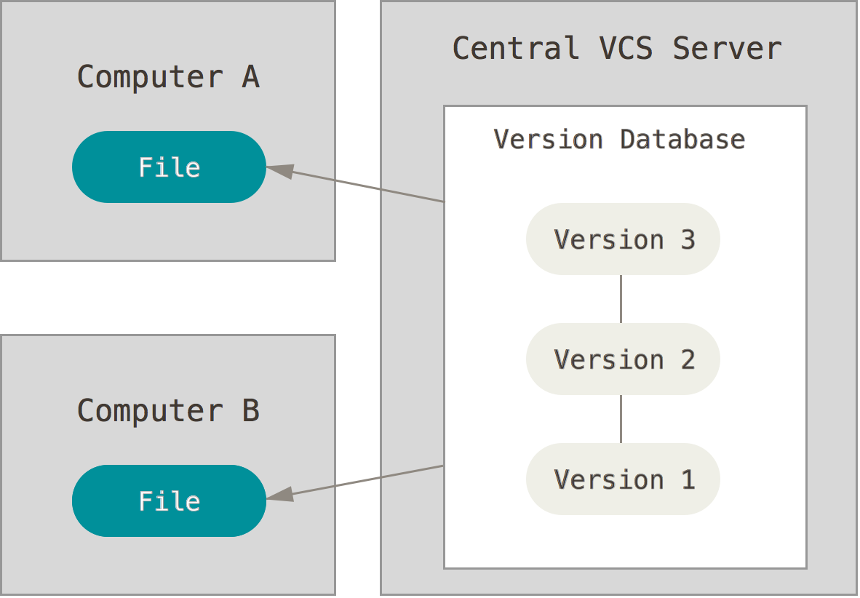
2. Centralized Source Control
Single point of integration
Single point of failure
TFS, Subversion
http://git-scm.com/book/en/v2

Slide 7
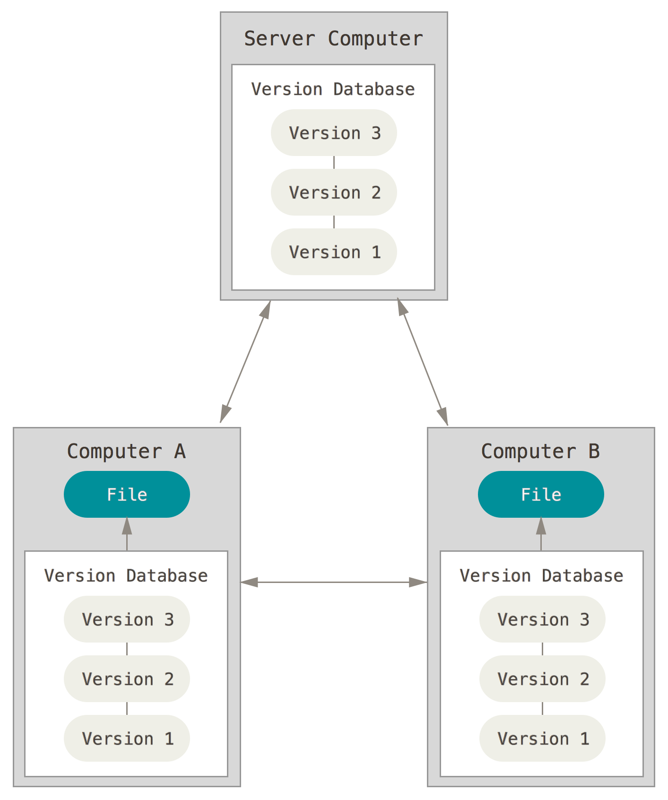
3. Distributed Source Control
Fully fault tolerant
Numerous development models are supported
Multiple paths of work
GIT, Mercurial
http://git-scm.com/book/en/v2

Slide 8
Brief history of GIT
GIT grew out of the community involved with Linux Kernel Development.
Prior to GIT, the community had been using a commercial product, Bitkeeper, for its Source Control solution.
In 2005, GIT was written as its replacement.

Slide 9
GIT’s Goals
Speed
Simple design
Strong support for non-linear development
Fully distributed
Able to handle large projects efficiently
http://git-scm.com/book/en/v2

Slide 10
Snapshots vs. Diffs
GIT thinks about versioning differently than most other systems
Each commit is a snapshot of the entire codebase that can be pulled down quickly
Only differences are stored, not full directory listings. Points in time are generated from history

Slide 11
Location, location, location
Nearly everything with GIT is done locally
Really fast when compared with online-only, or online-mostly SC. (TFS)
Work offline with nearly no differences in how you work until you’re ready to share your code
Changes worth sharing can be pushed to remote repo or requested to be added via a Pull Request.

Slide 12
Integrity & Security
Everyone who has pulled down the code has all the history of the project. Lose a machine? No problem, just pull from another machine’s repo.
Everything has a SHA-1 hash checksum. It’s nearly impossible to make a change without GIT knowing about it and storing it in the repo history.
Find any commit you’ve ever committed to the master branch, and roll back to that state any time.

Slide 13
Big Rocks - workflow
Working Directory
The current state of things on your local machine
Staging Area
Changes that have been promoted and are ready to be committed to a repo.
Does not have to align to your Working directory’s current state.
Repository
Where code goes when you want to share it with others
Current state can be pulled down at any time into your Working Directory
Semi-permanent storage. Should only go forward, almost never has history rewritten

Slide 14
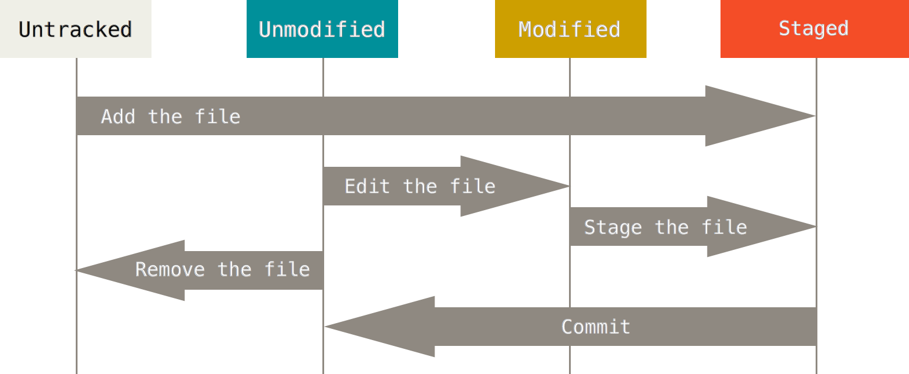
Change Lifecycle
http://git-scm.com/book/en/v2

Slide 15
GIT Console - Windows
GIT Shell
Installs with GIT for Windows
Leverages PowerShell
Cygwin GIT (msysGIT)
Similar to a Bash shell

Slide 16
GIT config
Ignore files and directories selectively (not my dlls!)
Customize DIFF and MERGE tools
Set your home directory (also easy in GIT Windows)
Global or local

Slide 17
GIT…
via its
commands

Slide 18
GITing help
GIT HELP
GIT HELP <verb>
GIT <verb> --HELP

Slide 19
>GIT INIT

Slide 20
GIT INIT
Makes your current directory GIT-tastic
Adds a hidden .GIT folder that stores your index
Run it anywhere you like, GIT anything at all.
Not necessary if you do a CLONE of an existing repository. In fact, I usually create on GitHub and do a clone instead of using INIT.
Creates a default ‘master’ branch to work out of and sets your current Working Directory to ‘master’ (CHECKOUT MASTER).

Slide 21
>GIT CLONE

Slide 22
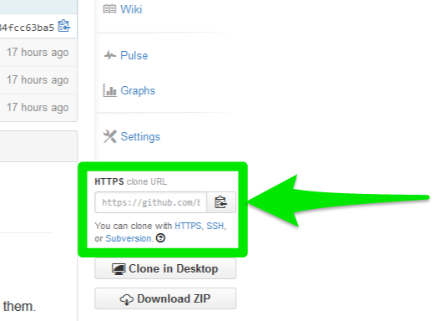
GIT CLONE https://github.com/ballance/GitTipsAndTricks.git
Makes your local directory a Working Directory for a remote repository
Does all the same things that GIT INIT does, but also wires up everything for you to PUSH, PULL, FETCH, MERGE, etc.
Do this one directory *above* where you want the project’s root Working Directory.
Get the URL from the GitHub website
Chris Ballance

Slide 23
>GIT ADD

Slide 24
GIT ADD
Adds a file to your local staging area
GIT ADD *
GIT ADD filename.cs
GIT ADD * -u

Slide 25
>GIT COMMIT

Slide 26
GIT COMMIT
Commits to your local repo, ready for push to a remote repo
GIT COMMIT
Opens a text editor to make comments
GIT COMMIT –m ‘Something amazing’

Slide 27
>GIT MERGE or GIT MERGETOOL

Slide 28
GIT MERGE <branch-to-merge-from>
Merges another branch (even remote) to your local branch in your current Working Directory
Can be tricky at the command line if there are conflicting changes.
GIT MERGETOOL (if configured) is much preferred
Read all about merging here…
http://git-scm.com/book/en/v2/Git-Branching-Basic-Branching-and-Merging

Slide 29
>GIT STATUS

Slide 30
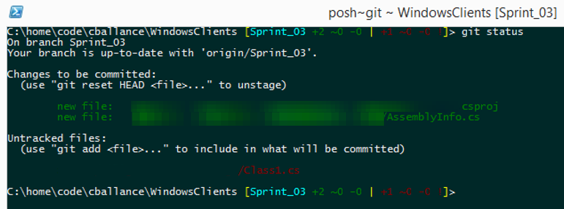
GIT STATUS
Chris Ballance

Slide 31
>GIT CHECKOUT

Slide 32
GIT CHECKOUT <branch-name>
Changes your active branch
GIT CHECKOUT dev
GIT CHECKOUT origin/dev
GIT CHECKOUT cballance/Sprint_03
GIT CHECKOUT-b new_branch
Create a new branch and switch to it

Slide 33
>GIT BRANCH

Slide 34
GIT BRANCH
Creates a new branch in your Working Directory
A branch maps to a Commit
GIT BRANCH new-branch
Create a new `new-branch` branch
GIT BRANCH -d new-branch
Delete the ‘new-branch’ branch from local

Slide 35
WORKING WITH REMOTES

Slide 36
>GIT FETCH

Slide 37
GIT FETCH
Fetches refs (branches & tags) from another repository, but does not automerge like GIT PULL.
By default will FETCH from origin, but any remote can be specified or --ALL to FETCH from all the remotes you have configured
GIT FETCH doesn’t change anything in your working directory, but will update your status with any remote changes not synchronized with your Working Directory
GIT FETCH then GIT MERGE is safer than GIT PULL

Slide 38
>GIT PUSH

Slide 39
GIT PUSH
Updates remote repo with local commits
Requires a MERGE to be done prior to PUSHing
Will PUSH to origin by default, but other repos can be specified
Individual branches can be specified
-u will set an new upstream remote so that they stay in sync

Slide 40
>GIT PULL

Slide 41
GIT PULL
Actually does a GIT FETCH then GIT MERGE behind the scenes
Doing FETCH and MERGE separately is what I prefer.

Slide 42
HISTORY What the heck did I do yesterday?

Slide 43
>GIT LOG

Slide 44
GIT LOG
See a list of commits back to the very beginning
GIT LOG <filename>
GIT LOG --MERGES
GIT LOG --PRETTY=oneline
GIT LOG --graph --PRETTY=oneline

Slide 45
UNDO / REDO
OOPS…

Slide 46
>GIT RESET

Slide 47
GIT RESET <file-name>
Roll back changes in your local index (staging area) to the version before you did GIT ADD.
Puts the repo version back in your working directory
Can change history
Can also reset your Working Directory
Be *careful* using the --hard flag.

Slide 48
>GIT CHECKOUT For individual files

Slide 49
GIT CHECKOUT <file-name>
Get the local repo version of a specific file
Puts the repo version back in your working directory
Does not change committed history

Slide 50
>GIT REVERT

Slide 51
GIT REVERT <file-name>
With existing commits, revert uncommitted changes. Requires clean working directory.
With --hard option, GIT will throw away all your uncommitted changes. Be *careful* with this.

Slide 52
>GIT DIFFTOOLs

Slide 53
GIT DIFFTOOL / MERGETOOL
Same functionality as GIT DIFF, but using your favorite comparison tool
Beyond Compare
DiffMerge
May require a few config changes

Slide 54

>GIT STASH
https://www.flickr.com/photos/mogus/

Slide 55
GIT STASH stash@{n}
Quick save of changes in your current branch
Lets you switch branches without committing.
GIT STASH SAVE
GIT STASH APPLY
GIT STASH LIST

Slide 56
REVERT / CHECKOUT / RESET
What’s the difference?
Dan Moulding has a great condensed guide
http://stackoverflow.com/a/8358039/1551

Slide 57
“SYNC”

Slide 58
“SYNC”
GIT doesn't have the concept of "sync" natively, per-se. It separates sync into PULL PUSH and alternatively PULL into the two part process GIT FETCH then GIT MERGE
Visual Studio's GIT plug-in uses the concept of 'sync' to do PULL or a PUSH behind the scenes

Slide 59



VISUAL TOOLS

Slide 60
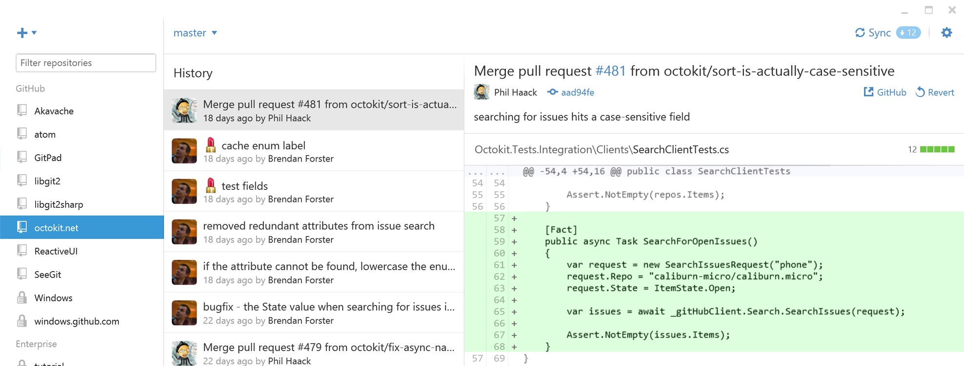
GitHub for Windows
photo: Phil Haack

Slide 61
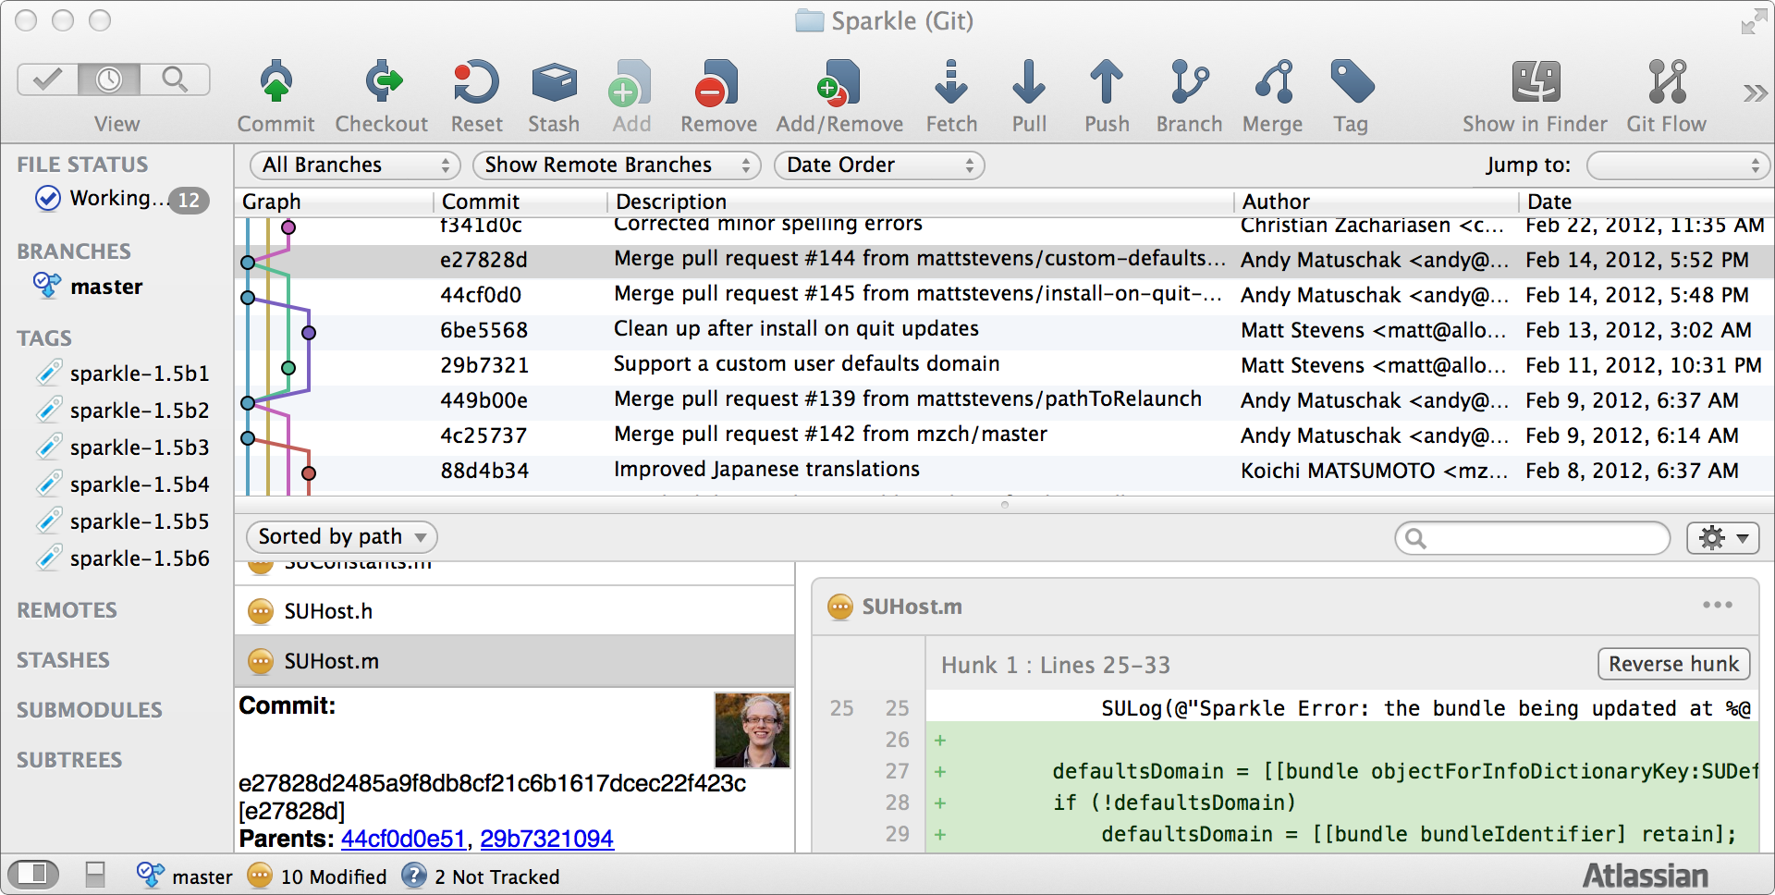
SourceTree
photo: Atlassian

Slide 62
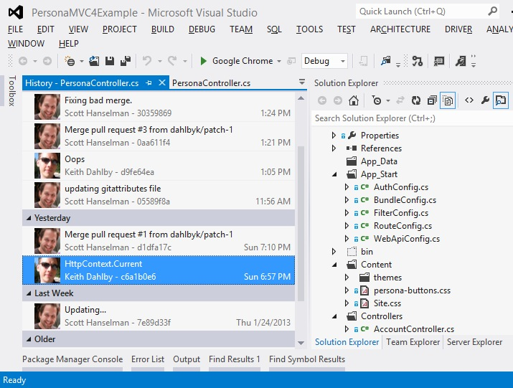
Visual Studio Integration
photo: Scott Hanselman - http://www.hanselman.com/blog/GitSupportForVisualStudioGitTFSAndVSPutIntoContext.aspx

Slide 63
Resources
Pro GIT - http://git-scm.com/book/en/v2
Stackoverflow.com - http://stackoverflow.com/questions/tagged/git
Google - http://lmgtfy.com/?q=git

Slide 64
>GIT QUESTIONS?

